Slide 1
MICROSOFT MOVIES

Slide 2
Table of contents
01
02
03
04
05
06
Introduction
Business Problem
Objectives
Conclusion
Data Understanding
Exploratory Data Analysis

Slide 3

Introduction
Microsoft is a multinational technology company known for its software products and services, including the Windows operating system and productivity tools like Microsoft Office, as well as cloud computing services through Azure and other innovative solutions

Slide 4

Business Problem
Microsoft wants to start creating original video content but do not have enough knowledge and expertise on how to go about it in order for it to be a success.

Slide 5
Objectives
1.
2.
To identify the top movie genres
To establish the directors of the top performing movies
3.
4.
To identify the time of the year for performing movies.
To ascertain which movie has the highest rating.

Slide 6

Success Criteria
Use Exploratory Data Analysis to get movie insights in order to give recommendations to Microsoft company.

Slide 7
Data Understanding
Rotten Tomatoes
IMDB
12 Features
1560 rows
9 Features
181387 Rows

Slide 8
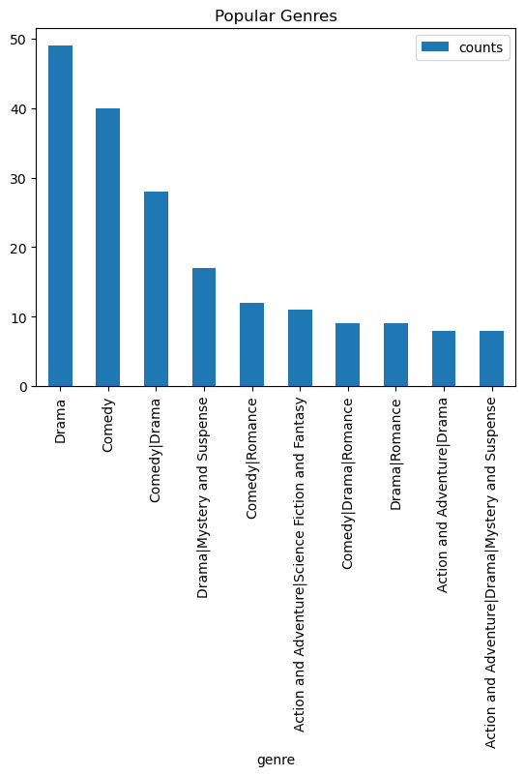
Exploratory data analysis
Most genre of movies produced are Drama and Comedy.

Slide 9
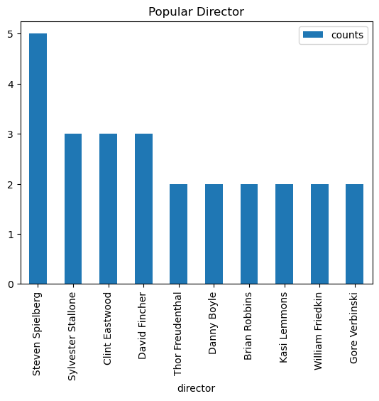
Exploratory data analysis
Steven Spielberg has the highest number of movies produced.

Slide 10
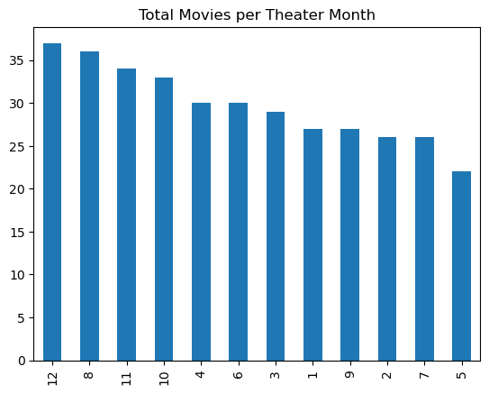
Exploratory data analysis
Majority of the movies are released to theaters in the last quarter of the year.

Slide 11
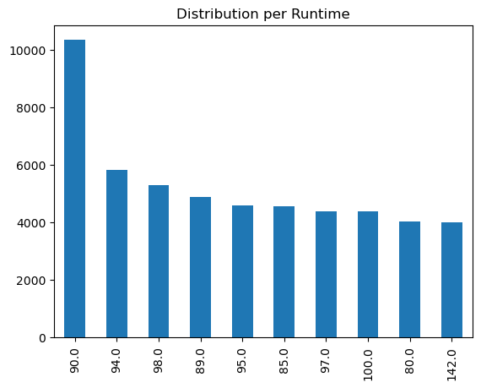
Exploratory data analysis
Over 10,000 movies have a runtime of 90 minutes.

Slide 12

Conclusions
Genre
Direcctor
Theater date
Majority of the movies produced are comedy and drama.
Steven Spielberg is the most preferred movie director.
Most movie theater are scheduled towards the end of the year.

Slide 13
Recommendations
Based on the findings from Exploratory Data Analysis of movies, Microsoft company should maximize on producing Drama and Comedy movies with a runtime of 90 minutes, using Steven Spielberg as the Director.
Microsoft should also release their movies on theaters during the last quarter of the year.

Slide 14

THANK YOU!

